Slide 1
OpenVox
Introduction
2022
OpenVox Communication Co., Ltd
VoIP Gateway
IP Communication System

Slide 2
https://www.ypppt.com/
01
Company Profile
02
Company Honor
CONTENT
目录
03
Company Products
04
Company Customers

Slide 3
“
01
PROFILE
COMPANY

Slide 4
`
Company Profile
Profile
OpenVox Communication Co., Ltd
Founded in 2002, OpenVox has now evolved to become a global leading provider of open source telephony hardwares and software products. OpenVox serves the Small and Medium Business and open source markets with superior quality products that lower communication costs, increase system flexibility and enhance productivity in building PBX, Call Center, IVR and firewall applications. OpenVox continues to deliver innovative and cost effective solutions to the open source communities and will always do.
Go Now

Slide 5
“
02
HONOR
COMPANY

Slide 6
Company Honor
Company Honor
Except for products and services, OpenVox is also complimented for environmental protection. It is not only the first supplier to meet EU RoHS green environmental protection standard, but also adopt thin card design with CE、FCC certificate and more than ten special certificates in some local countries.

Slide 7
Company Honor
Timeline
Top three of Asterisk telephone card suppliers；
Cooperated with Elastix
Branch company was founded in California
Created stacked communication all-in-one machine-UCP
2008
2009
2013
2014
2015
2016
Achieved Double-Soft Enterprise
Branch office was founded in Wuhan；
Achieved high-tech enterprise certificates
OpenVox Yun education achieved 3C certificate

Slide 8
Company Honor
Timeline
Won the "Editor's Recommendation Award" of CTI Forum
Released UC Series IPPBX
Launched Multiple Slots Simbank Successfully
Released iAG200/400
Analog Gateway
2017
2018
2018
2019
2020
2021
2022
Announced new generation SWG Series Wireless Gateway
Launched New
SWG-2016/32-4S Multi-SIM Wireless Gateway
Released the newest MAG1000 Analog Gateway，
SWG-3008/16/32 Wireless Gateway

Slide 9
“
03
PRODUCTS
COMPANY

Slide 10
Main Products
① VoIP Gateway
③ IP Phone
VoIP gateways convert information, data or other communications from one protocol or format to another.
IP phone, also known as broadband phone or Internet phone, uses voice over IP technologies for placing and transmitting telephone calls over an IP network
② IPPBX
④ Telephony Card
IPPBX delivers a multi-functional business office telephony system designed for almost all kinds of enterprises.
OpenVox Telephony card delivers great voice quality in the telephony systems. It supports industry standard telephony and data protocols.

Slide 11
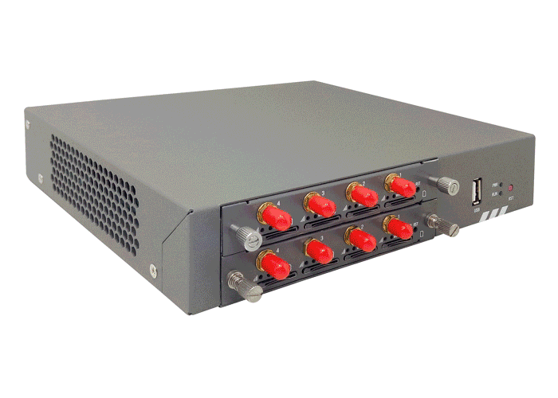
Products
①VoIP Gateway
Wireless Gateway
1.VoxStack Series Wireless Gateway
2.SWG Series Wireless Gateway
Analog Gateway
1.Integrated Analog Gateway
2.Modular Analog Gateway
E1/T1 Gateway
1.Integrated E1/T1 Gateway
2.Modular E1/T1 Gateway

Slide 12
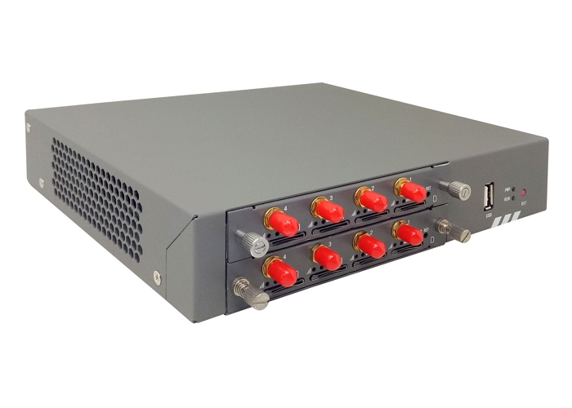
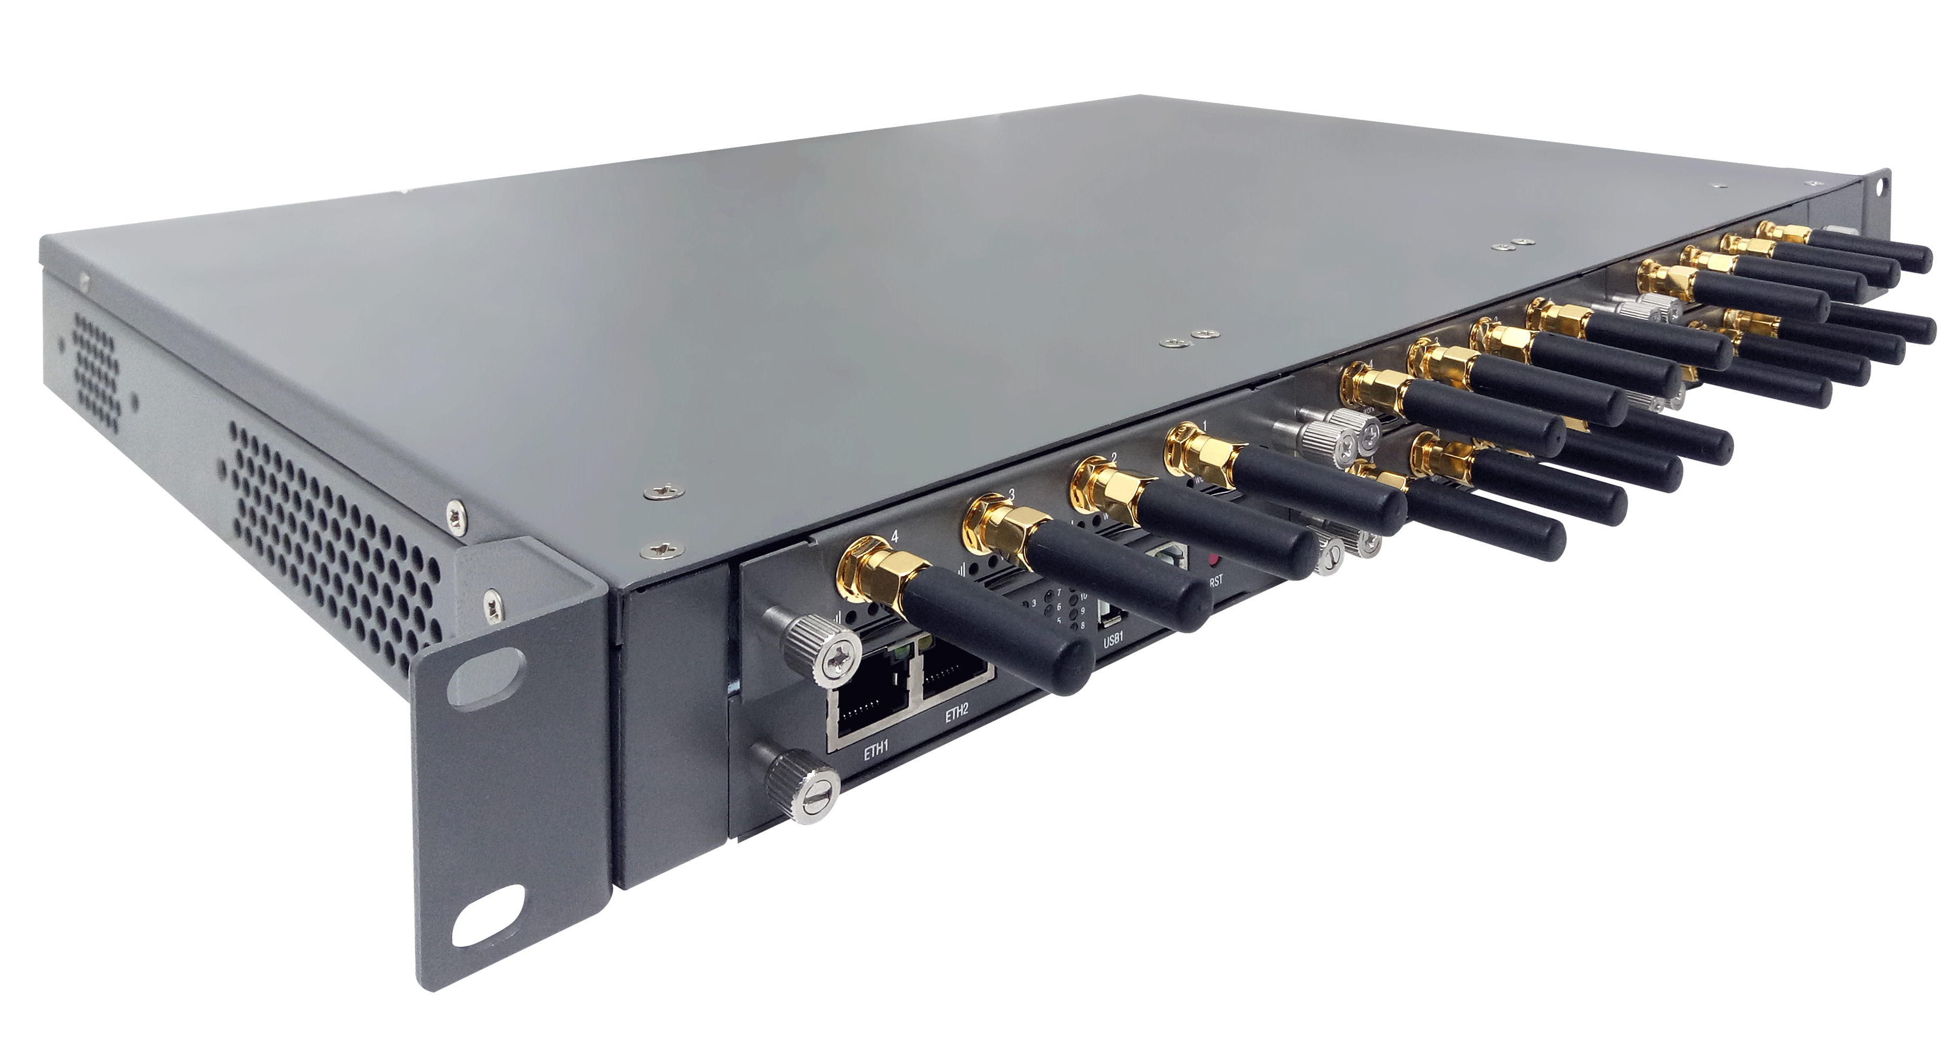
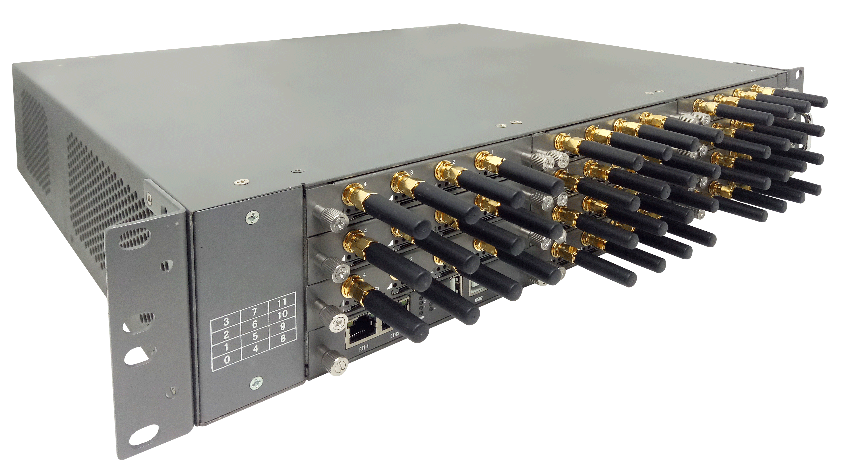
Wireless Gateway —— VoxStack Series
01
02
03
VS-GW1202 V2 Series
VS-GW1600 V2 Series
VS-GW2120 V2 Series
Provides up to 2 plug-in GSM/ WCDMA/LTE gateway modules
Support 4 or 8 GSM/WCDMA/ LTE channels
Provides up to 5 plug-in GSM/ WCDMA/LTE gateway modules
Support from 4 to 20 GSM/ WCDMA/LTE channels and 2 Ethernet ports
Provides up to 11 plug-in GSM/ WCDMA/LTE gateway modules
Support 4 or 44 GSM/WCDMA/ LTE channels and 2 Ethernet ports

Slide 13
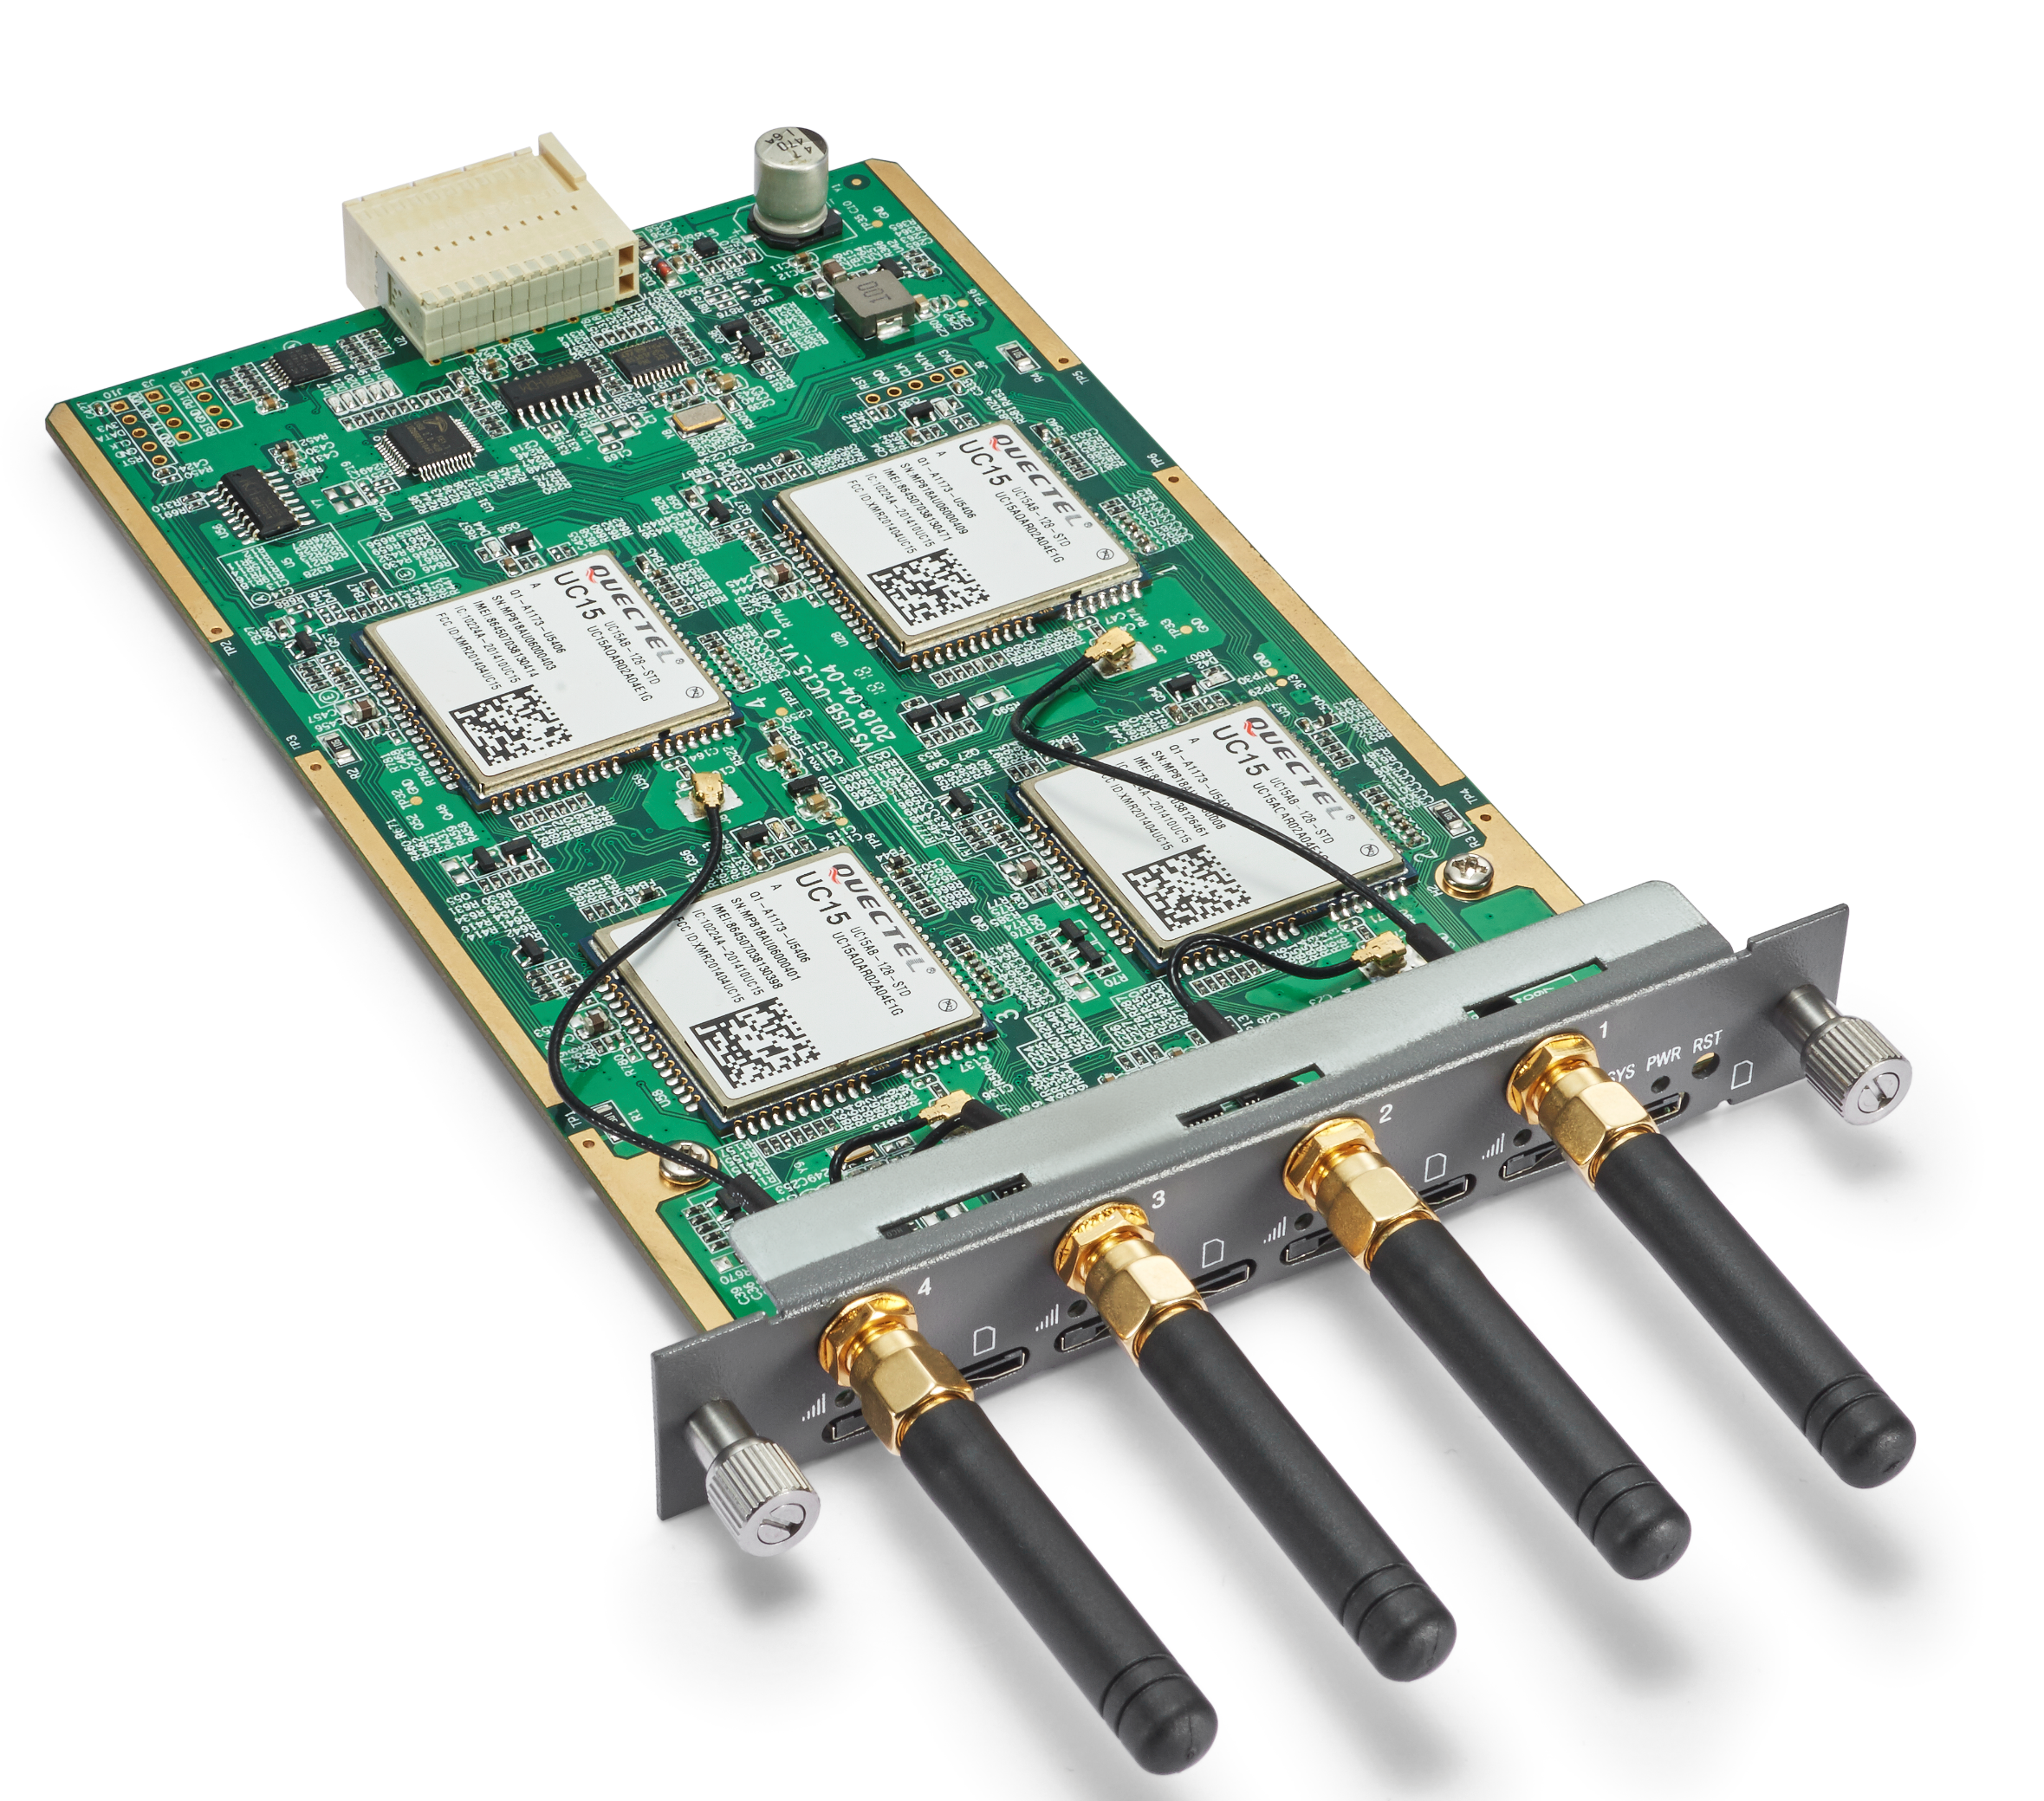
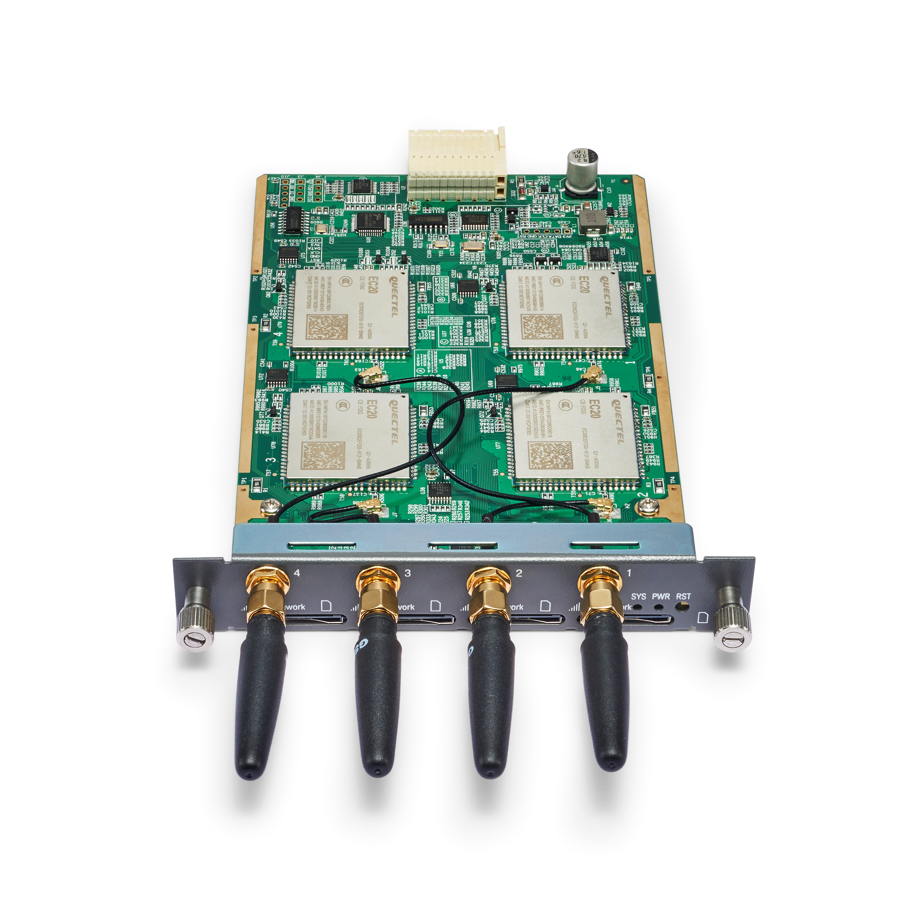
Wireless Gateway —— VoxStack Series Module
Wireless Gateway —— VoxStack Series Module
01
02
03
VS-GWM401G
VS-GWM401W
VS-GWM401L
Frequency range: GSM 850/900/1800/1900MHz
Each module offers 4 GSM channels
Frequency range:
VS-GWM420W-E Europe
900/2100MHz @UMTS
900/1800MHz @GSM
VS-GWM420W-A America
850/1900MHz @UMTS
850/900/1800/1900MHz @GSM
VS-GWM420W-T Thailand
850/2100MHz @UMTS
850/900/1800/1900MHz @GSM
Frequency range:
VS-GWM420L-CE R2.1 China/India
LTE FDD: B1/B3/B5/B8 LTE TDD: B38/B38/B40/B41
WCDMA: B1/B8 TD-SCDMA: B34/B39
CDMA: BC0 GSM: 900/1800MHz
VS-GWM420L-E EMEA/Korea/Thailand
LTE FDD: B1/B3/B5/B7/B8/B20 LTE TDD: B38/B40/B41
WCDMA: B1/B5/B8 GSM: B3/B8
VS-GWM420L-AU
Australia/New Zealand/Taiwan/Brazil
LTE FDD: B1/B2/B3/B4/B5/B7/B8/B28
LTE TDD: B40
WCDMA: B1/B2/B5/B8 GSM: B2/B3/B5/B8
Each module offers 4 3G/UMTS channels
Each module offers 4 LTE channels

Slide 14
Wireless Gateway —— VoxStack Series Module
Wireless Gateway —— VoxStack Series Module
04
05
06
VS-GWM420G
VS-GWM420W
VS-GWM420L
Frequency range: GSM 850/900/1800/1900MHz
Each module offers 4 GSM channels
Frequency range:
VS-GWM420W-E Europe
900/2100MHz @UMTS
900/1800MHz @GSM
VS-GWM420W-A America
850/1900MHz @UMTS
850/900/1800/1900MHz @GSM
VS-GWM420W-T Thailand
850/2100MHz @UMTS
850/900/1800/1900MHz @GSM
Frequency range:
VS-GWM420L-CE R2.1 China/India
LTE FDD: B1/B3/B5/B8 LTE TDD: B38/B38/B40/B41
WCDMA: B1/B8 TD-SCDMA: B34/B39
CDMA: BC0 GSM: 900/1800MHz
VS-GWM420L-E EMEA/Korea/Thailand
LTE FDD: B1/B3/B5/B7/B8/B20 LTE TDD: B38/B40/B41
WCDMA: B1/B5/B8 GSM: B3/B8
VS-GWM420L-AU
Australia/New Zealand/Taiwan/Brazil
LTE FDD: B1/B2/B3/B4/B5/B7/B8/B28
LTE TDD: B40
WCDMA: B1/B2/B5/B8 GSM: B2/B3/B5/B8
Each module offers 4 3G/UMTS channels
Each module offers 4 LTE channels

Slide 15
Wireless Gateway —— VoxStack Series
VoxStack Series Wireless Gateway
VS-GWM420/401 Series Wireless Gateway Modules
Product Name | VS-GWM420 | VS-GWM401
Switch Board
Core Board | Y (4-Core Intel) | Compatible with V1&V2 Switch Board
Bus | Ethernet + USB
Reset | Y | N
Module Board
CPU | N | Y
Bus | USB | Ethernet
Reset | N | Y
Function
Cluster | Switch Board control each Module Board | N
Firmware Update and Maintenance | Function is basically the same, continuously updating versions and features

Slide 16
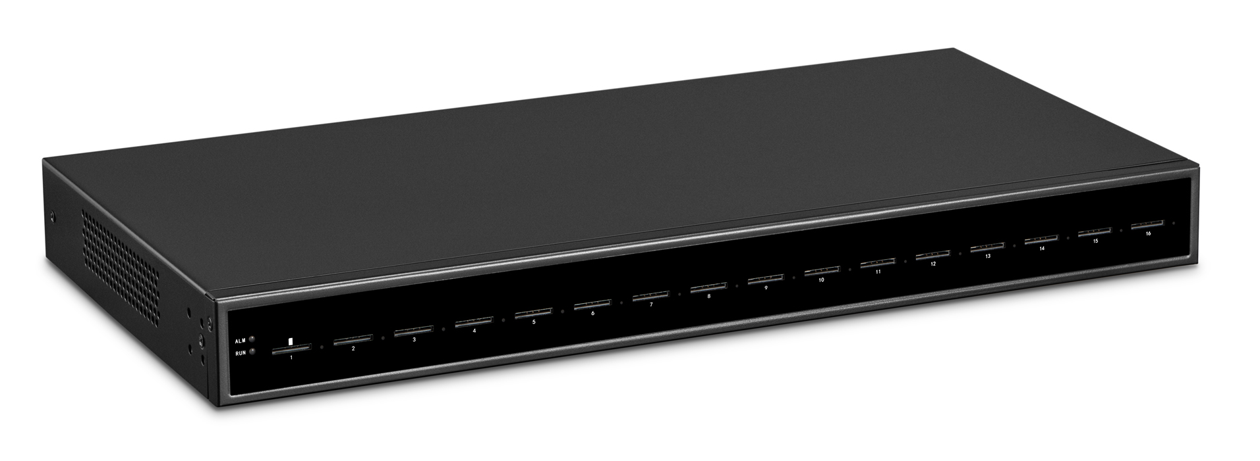
Wireless Gateway —— SWG Series
VoxStack Series Wireless Gateway
VoxStack Series Wireless Gateway
01
02
03
SWG-3008
SWG-3016/32
SWG-3016/32-4S
Provides 8 GSM/WCDMA/LTE channels
Hot-swap SIM cards with no service interruption
Equipped with double Ethernet ports that meet various need
Provides 16/32 GSM/WCDMA/ LTE/ channels
Hot-swap SIM cards with no service interruption
Equipped with double Ethernet ports that meet various need
Policy-based SIM Auto Switch
Dynamic allocation of SIM cards
Support a variety of protocol ranges
Provides 16/32 GSM/WCDMA/LTE channels

Slide 17
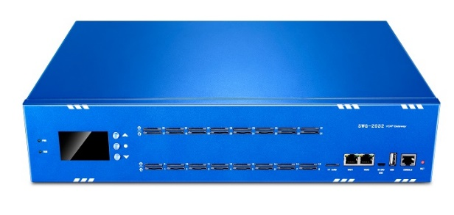
Wireless Gateway —— SWG Series
VoxStack Series Wireless Gateway
VoxStack Series Wireless Gateway
03
04
05
SWG-2016/32
SWG-2016/32-4S
SWG-M202/204
Provides 16/32 GSM/CDMA/ WCDMA/LTE/VoLTE channels
LCD Control and Display system
HD Voice Codecs
Provides 16/32 GSM/LTE channels
4 SIM card slots per GSM/LTE port
Centralized management of up to 128 SIM cards
Unique LCD screen design
Supports multiple HD codecs
Supports 2/4 GSM/CDMA/ WCDMA/LTE/VoLTE channels
Designed for Small and Medium Enterprises, SOHOs
Compact, light and convenient
Abundant HD Voice Codecs

Slide 18
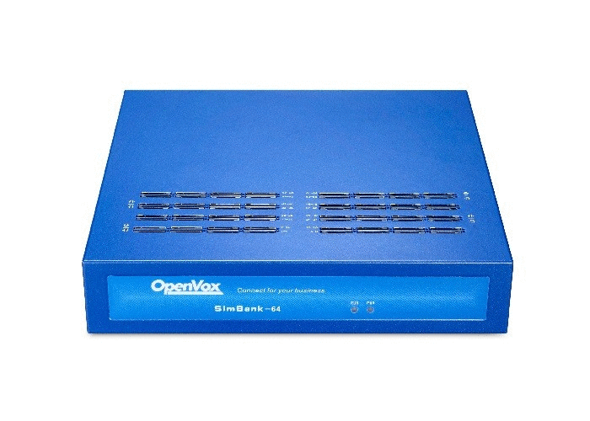
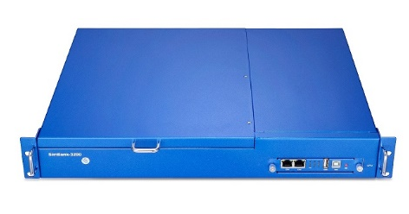
VoxStack Series Wireless Gateway
VoxStack Series Wireless Gateway
Wireless Gateway —— Match up with Simbank
01
02
Simbank-64/128
Simbank-320
64/128/320 SIM Slots depends on need
Match up with OpenVox Wireless Gateways perfectly
Hot Swap of SIM Cards with No Service Interruption
Dynamic Allocation of SIM Cards
Compatible with 2G/3G/4G SIM cards
Credible data transmission, and support internal network penetration
Support Remote Sim Card Management and Information Exchange

Slide 19
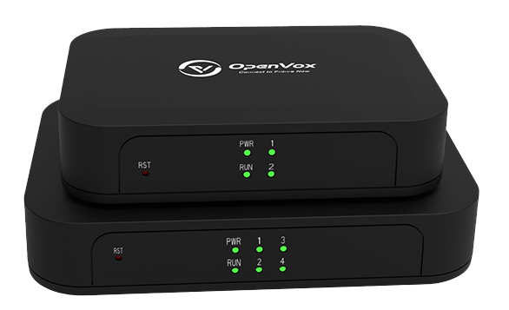
Analog Gateway —— Integration
VoxStack Series Wireless Gateway
01
02
03
iAG200/400
iAG800 V2 Series
MAG1000 Series
Use standard SIP protocols
Designed for SMBs and SOHOs
Supports 2/4 FXS/FXO ports
Use standard SIP protocols
Designed for SMBs and SOHOs
Supports 4/8 FXS/FXO ports
Use standard SIP protocols
Supports 16/24/32 FXS/FXO port combination
Compatible with Leading IMS/NGN platform，IPPBX and SIP servers

Slide 20
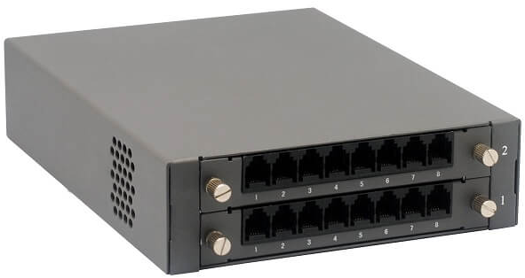
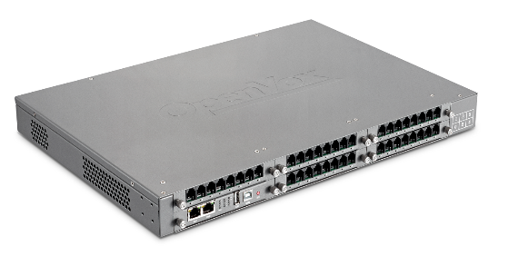
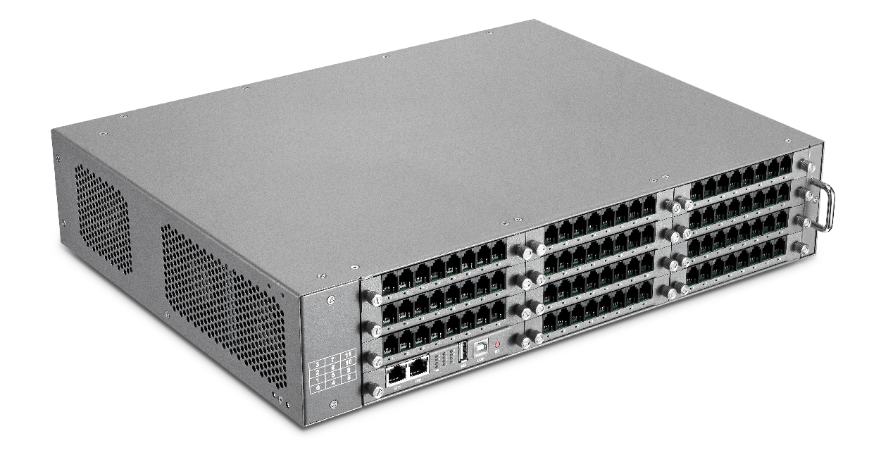
Analog Gateway —— Modular
VoxStack Series Wireless Gateway
01
02
03
VS-GW1202 V2
VS-GW1600 V2
VS-GW2120 V2
Supports up to 16 FXS/ FXO channels
Designs with 2 LAN switch boards
Supports up to 40 FXS/FXO channels
Designs with 2 LAN switch boards
4 cores intel CPU inside
Up to 88 concurrent calls with transcoding and EC

Slide 21
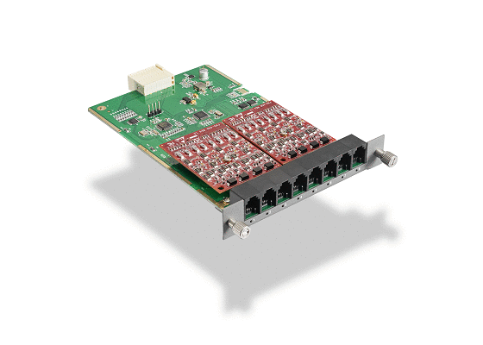
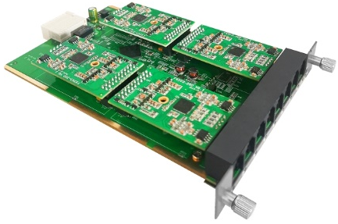
Analog Gateway —— Modular
VoxStack Series Wireless Gateway
04
05
VS-GWM801
VS-GWM820
Each VS-GWM801-O module offers 8 FXO ports
Each VS-GWM801-S module offers 8 FXS ports
Each VS-GWM801-O/S module offers 4 FXO ports and 4 FXS ports
Each VS-GWM820-O module offers 8 FXO ports
Each VS-GWM820-S module offers 8 FXS ports
Each VS-GWM820-O/S module offers 4 FXO ports and 4 FXS ports

Slide 22
Analog Gateway —— Modular
VoxStack Series Wireless Gateway
Difference between VS-GWM801/820 Series Analog Modules
Product Name | VS-GWM801 | VS-GWM820
Switch Board
Core Board | N | Y (4-Core Intel)
Bus | Ethernet | Ethernet + USB
Reset | N | Y
Module Board
CPU | Y (4-Core ARM) | N
Bus | Ethernet | USB
Reset | Y | N
Function
Cluster | N | Switch Board control each Module Board
Firmware Update and Maintenance | Function is basically the same, continuously updating versions and features

Slide 23
E1/T1 Gateway —— Integration
VoxStack Series Wireless Gateway
01
02
DGW-L20X
DGW-100X(R)
Supports 1/2/4 software-selectable T1/E1/PRI interface
Up to 120 energy efficiency concurrent processing
Signalling: PRI/R2/SS7
Echo Cancellation & transcoding
Supports 1/2/4 software-selectable E1/T1/PRI interface
Supports up to 30/60/120 concurrent calls
Signalling: PRI/SS7/R2
Echo Cancellation & transcoding (Octasic® DSP)
Support redundant power supply

Slide 24
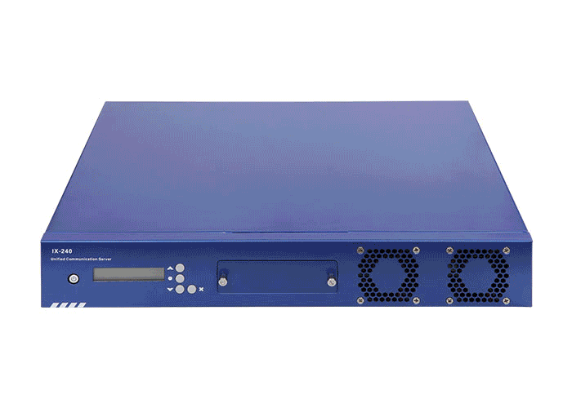
Products
②IPPBX
IX Series
IX160、IX240
UC Series
UC501、UC300
Unified Communication Platform
Host、Main Control Module、Gateway Module、
Accessories

Slide 25
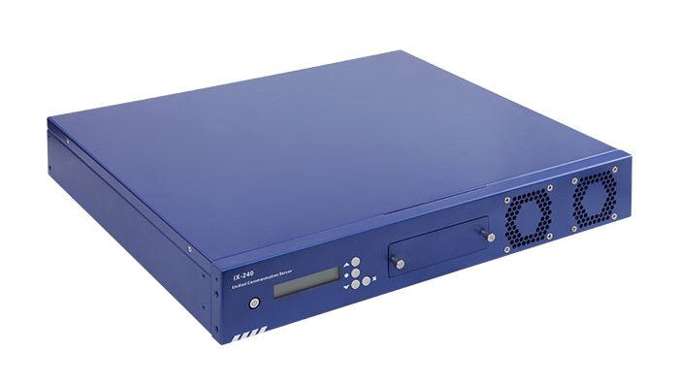
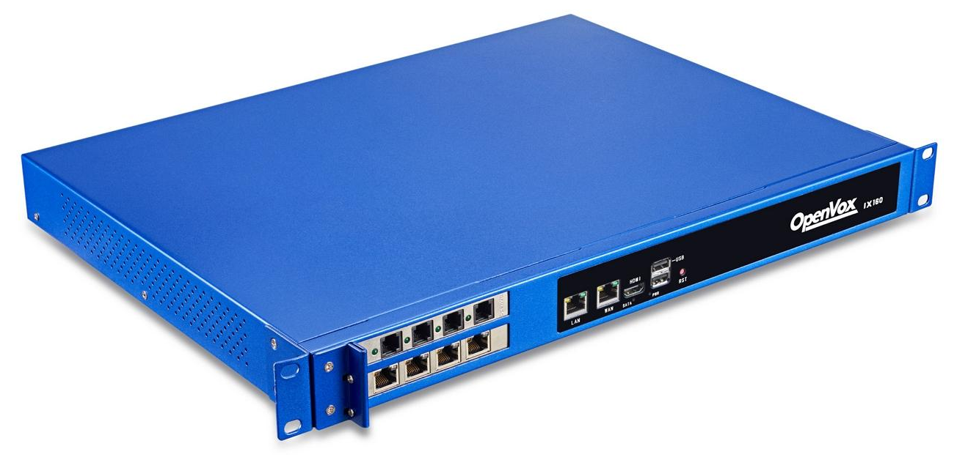
IPPBX—— IX Series
VoxStack Series Wireless Gateway
01
02
IX240
IX160/160P
Supports combination of two cards, includes FXS/FXO, BRI, E1/T1/J1 or transcoding interfaces
Can easily handle 300 concurrent calls.
Uninterruptible Power Supply (UPS): Yes (Optional)
RAID: Yes (Optional)
Built-in Redundant Power Supply (RPS)
Product | IX160/160P
Support Cards | A/B/D Series OpenVox Telephony Cards
Network Interface | 2*10/100/1000M
CPU | Intel Quad Core Celeron / i5
RAM | 4/8/16GB (optional)
flash | mSATA SSD/2.5 inch
USB port | 1
SD slot | 1 (support up to 128G SD card)
UPS | Yes
Supports combination of two cards, includes FXS/FXO, BRI or E1/T1/J1 interfaces
Uninterruptible Power Supply (UPS): Yes (Optional)
RAID: Yes (Optional)
Built-in Redundant Power Supply (RPS)

Slide 26
IPPBX—— UC Series
01
UC300
Product | UC300
Analog Interfaces | 2-5
Network Interface | 2
UPS | Yes
Aluminum Enclosed Case and Fanless Design
Can easily handle 150 concurrent calls
Support industry standard SIP trunks, IAX2 trunks, analog PSTN trunks, and analog station trunks
Up to 5 Analog Ports with Failover Function
The Industry 1st IPPBX with Built-in Uninterruptible Power Supply

Slide 27
IPPBX—— UC Series
Product | UC501
Analog Interfaces | 2-8
Network Interface | 2
CPU | Intel Quad Core
RAM | 1GB
flash | 16GB
USB port | 1
SD slot | 1 (support up to 128G SD card)
UPS | Yes
02
UC501
Optimized Uninterruptible Power Supply
Modular design, customizable with FXO-200/FXS-200/FXOS-200 module
With Quad Core processors, UC501 can easily handle 150 concurrent calls and up to 1000 extension registers
Support industry standard SIP trunks, IAX2 trunks and analog PSTN trunks
It can seamlessly integrate VoIP trunks and your existing PSTN lines with maximum 8 port analog connections and 2 Ethernet ports

Slide 28
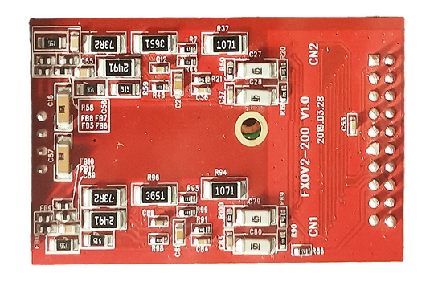
IPPBX——UC Series ——Module
VoxStack Series Wireless Gateway
01
02
03
FXO-200
FXS-200
FXOS-200
Allows OpenVox UC series IPPBX Module to terminate 2 analog PTSN lines per module
Allows OpenVox UC series IPPBX Module to terminate 2 analog telephone lines per module
Dual-channel module
Builds 1 FXO and 1 FXS channels with failover capability

Slide 29
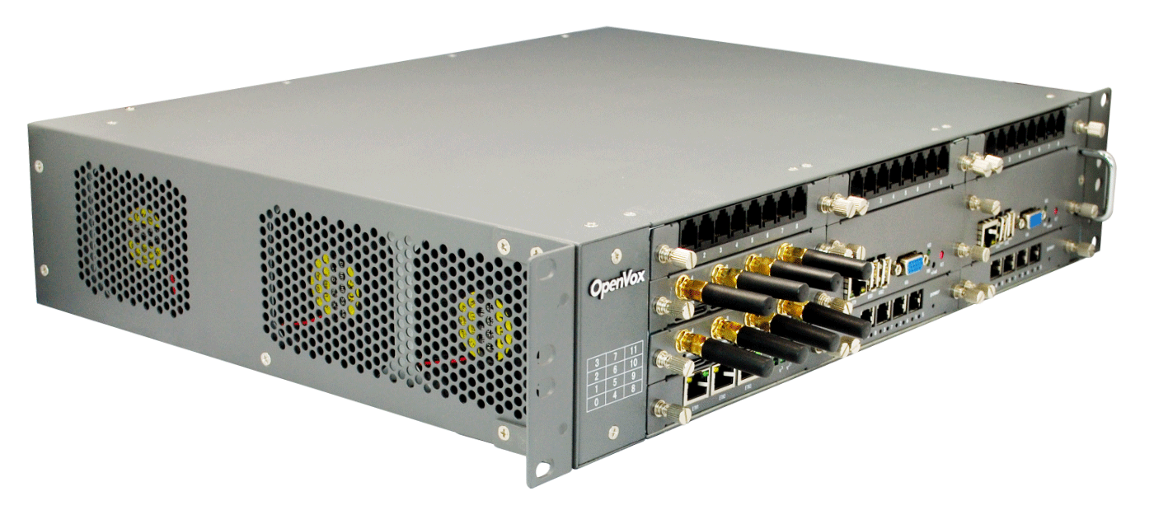
VoxStack Series Wireless Gateway
VoxStack Series Wireless Gateway
IPPBX—— Unified Communication Platform —— Host
01
02
03
2U Series VS-GW2120 V2
1U Series VS-GW1600 V2
Desktop VS-GW1202 V2
Provides up to 11 plug-in gateway modules
Supports from 4 to 44 channels and 3 Ethernet ports
Provides up to 5 plug-in gateway modules
Ranging from 4 up to 20 channels
Provides up to 2 plug-in gateway modules
Supports 4 or 8 channels and 2 Ethernet ports

Slide 30
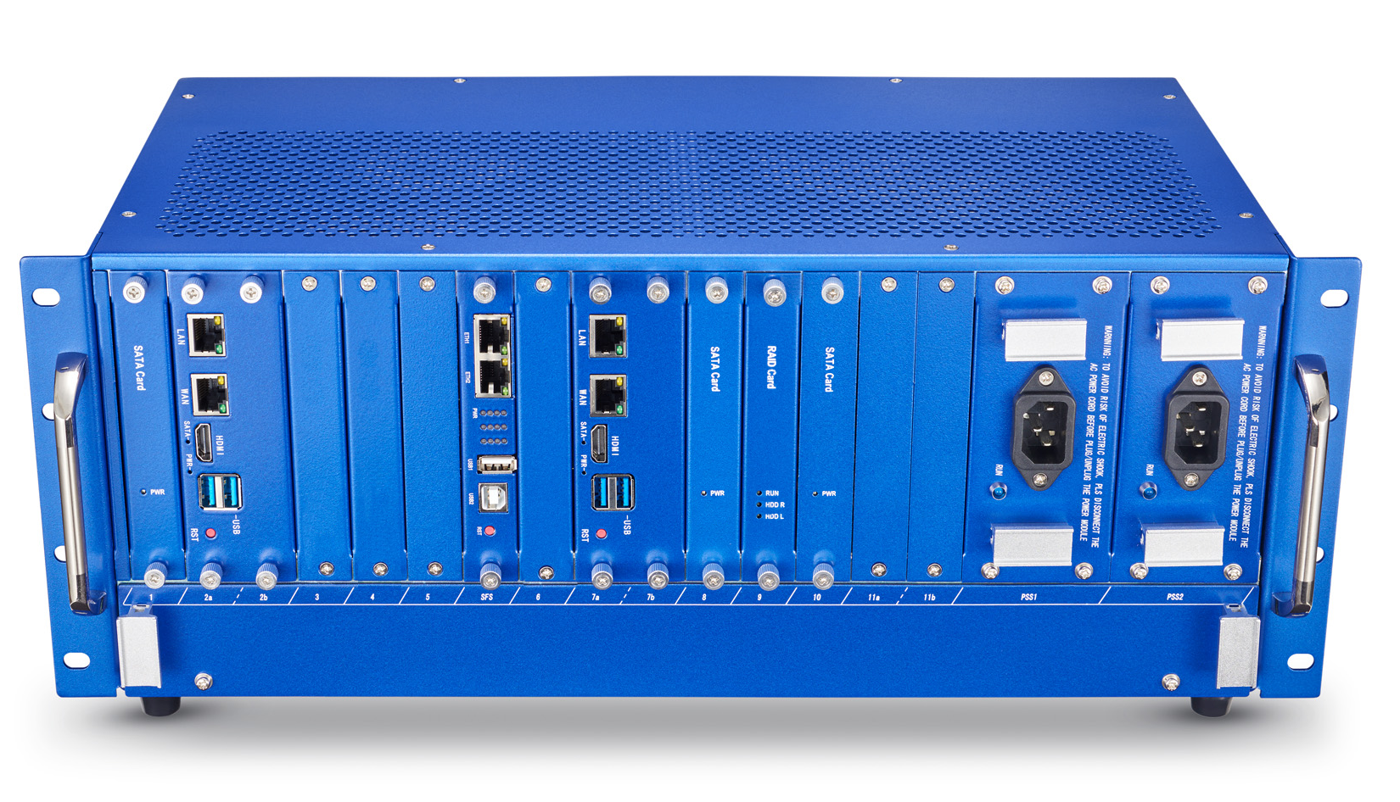
VoxStack Series Wireless Gateway
IPPBX—— Unified Communication Platform
Unified Communication Platform
UCP is an ideal solution to integrate data, voice and video in one product for SME market. The UCP supports FXS, GSM/WCDMA/LTE and E1/T1 interface modules and CPU board modules.
Each slot in an UCP chassis has a unique slot number start from 1, different model of chassis has different orientation. Each adapter installed will occupy at least 1 slot, some adapter models must be installed in special use slot. But most slots are equivalent.
UCP4130
Minimum default configuration：Chassis + Switch adaptor + fan box + 1pcs power supply module
Supports optional RAID, Redundant Power Supply
Supports Hot Standby
UCP4130 Slot Orientation
Slot 1 | Slot 2a&2b | Slot 3 | Slot 4 | Slot 5 | Slot SFS | Slot 6 | Slot 7a&7b | Slot 8 | Slot 9 | Slot 10 | Slot 11a&11b | Slot PSS1 | Slot PSS2

Slide 31
VoxStack Series Wireless Gateway
IPPBX—— Unified Communication Platform
Unified Communication Platform
UCP is an ideal solution to integrate data, voice and video in one product for SME market. The UCP supports FXS, GSM/WCDMA/LTE and E1/T1 interface modules and CPU board modules.
Slot# | Function | Available Modules
1 | Optional | A/B/C/W
2 | Optional | A/B/C/D/W
3 | Optional | A/B/C/W
4 | Optional | A/B/C/W
5 | Optional | A/B/C/W
6 | Optional | A/B/C/W
7 | Optional | A/B/C/D/W
8 | Optional | A/B/C/W
9 | Optional | A/B/C/W
10 | Optional | A/B/C/W
11 | Optional | A/B/C/D/W
PSS1 | Optional | E
PSS2 | Optional | E
Available Adapter of Each Slot
Shortcut for different adapters shown as below:
A is one pcs of adapter from these models: VS-GWM801-O，VS-GWM801-S，VS-GWM801O/S
B is one pcs of adapter from these models: VS-ET2004, VS-ET2002, VS-ET2001
W is VS-GWM401G/W/L
C is VS-CCU-N2930AM
D is VS-CCU-I5
E is VS-PSU-400

Slide 32
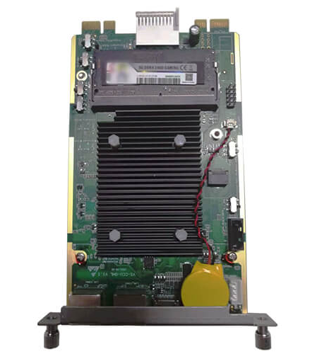
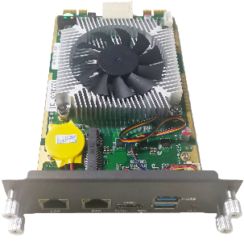
VoxStack Series Wireless Gateway
IPPBX—— Unified Communication Platform —— Main Control Module
VoxStack Series Wireless Gateway
01
02
03
VS-CCU-GML
VS-CCU-I5-8250U
VS-CCU-N2930AM
A new main control board developed for VoIP applications
1 USB port; 2Ethernet ports; 1HDMI port
CPU: 1.10G Intel(R) Celeron(R) N4120
RAM: Up to 8GB DDR3L 1333
A new version Asterisk® motherboard
Can easily handle 600/1000 concurrent calls with G.729/G.711 codec.
CPU: 3.20 GHz Intel(R) Core(R) CPU
RAM: Up to 32GB DDR4-2400
Asterisk® motherboard
Can easily handle 300 concurrent calls and up to 1000 users
CPU: 1.83GHz Intel(R) Celeron(R) N2930
RAM: Up to 8GB DDR3L 1333

Slide 33
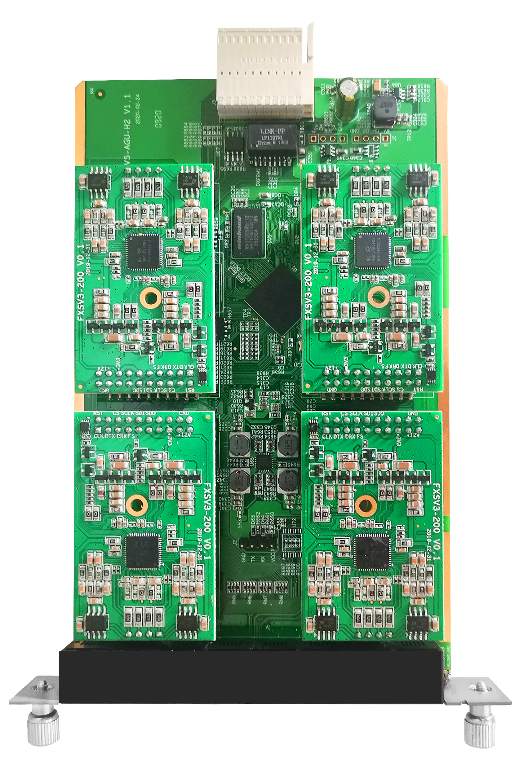
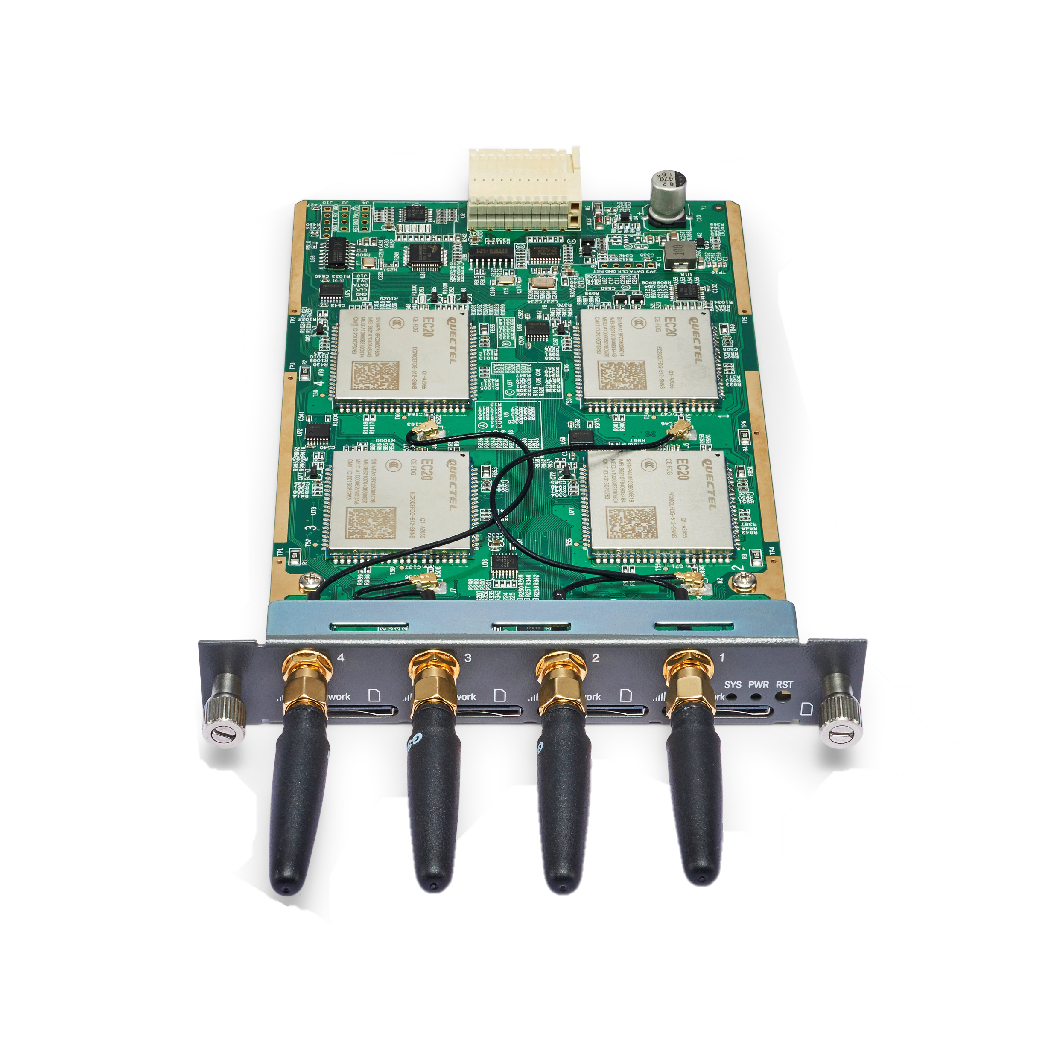
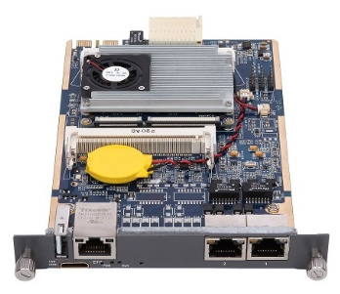
VoxStack Series Wireless Gateway
VoxStack Series Wireless Gateway
VoxStack Series Wireless Gateway
VoxStack Series Wireless Gateway
IPPBX—— Unified Communication Platform —— Gateway Module
01
02
03
VS-GWM801
VS-GWM401G/W/L
ET200X
Each VS-GWM801-O module offers 8 FXO ports.
Each VS-GWM801-S module offers 8 FXS ports.
Each VS-GWM801-O/S module offers 4 FXO ports and 4 FXS ports.
Each VS-GWM401G offers 4 GSM channels
Each VS-GWM401W offers 4 WCDMA channels
Each VS-GWM401L offers 4 LTE channels
Supports 1/2/4 software-selectable T1/E1/PRI interface
Supports up to 30/60/120 concurrent calls

Slide 34
VoxStack Series Wireless Gateway
IPPBX—— Unified Communication Platform
Unified Communication Platform
UCP is an ideal solution to integrate data, voice and video in one product for SME market. The UCP supports FXS, GSM/WCDMA/LTE and E1/T1 interface modules and CPU board modules.
Family Products
Wireless VoIP Adapter*
VS-GWM401G | 4-port GSM VoIP gateway adapter
VS-GWM401W | 4-port WCDMA VoIP gateway adapter
VS-GWM401L | 4-port LTE VOIP gateway adapter
Analog VoIP Adapter*
VS-GWM801-S | 8-port FXS VOIP gateway adapter
VS-GWM801-O | 8-port FXO VOIP gateway adapter
VS-GWM801-O/S | 4 FXO ports and 4 FXS ports VOIP gateway adapter
T1/E1/J1 Interface Adapter
ET2004 | 4-port T1/E1 adapter
ET2002 | 2-port T1/E1 adapter
ET2001 | 1-port T1/E1 adapter
Processor Adapter
VS-CCU-N2930AM | N2930Processor adapter, mSATA SSD (This adapter occupy 1 slot.）

Slide 35
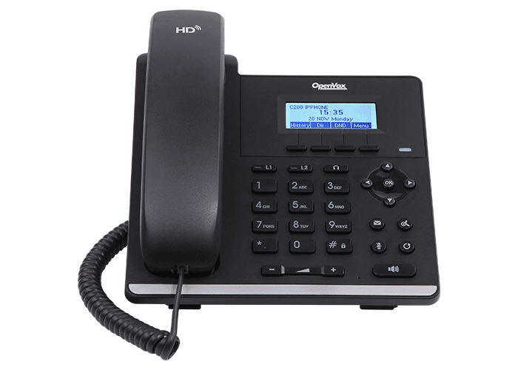
Products
③IP Phone
C Series IP Phone
C200、C401

Slide 36
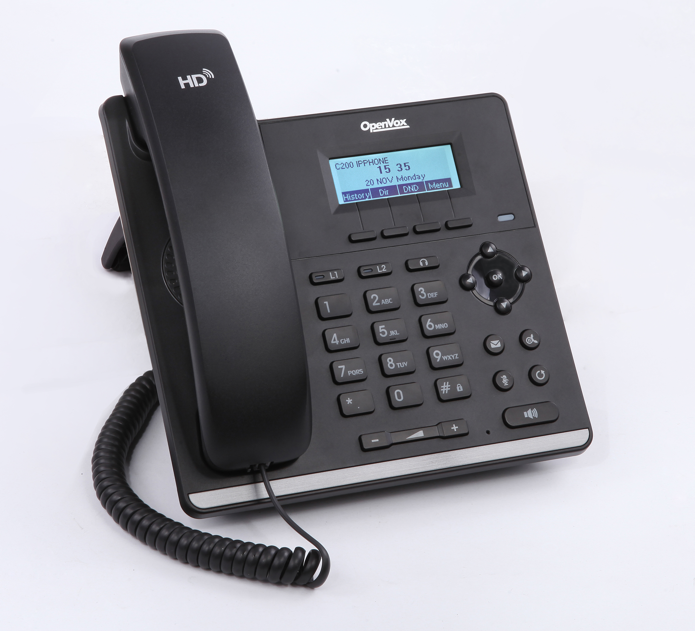
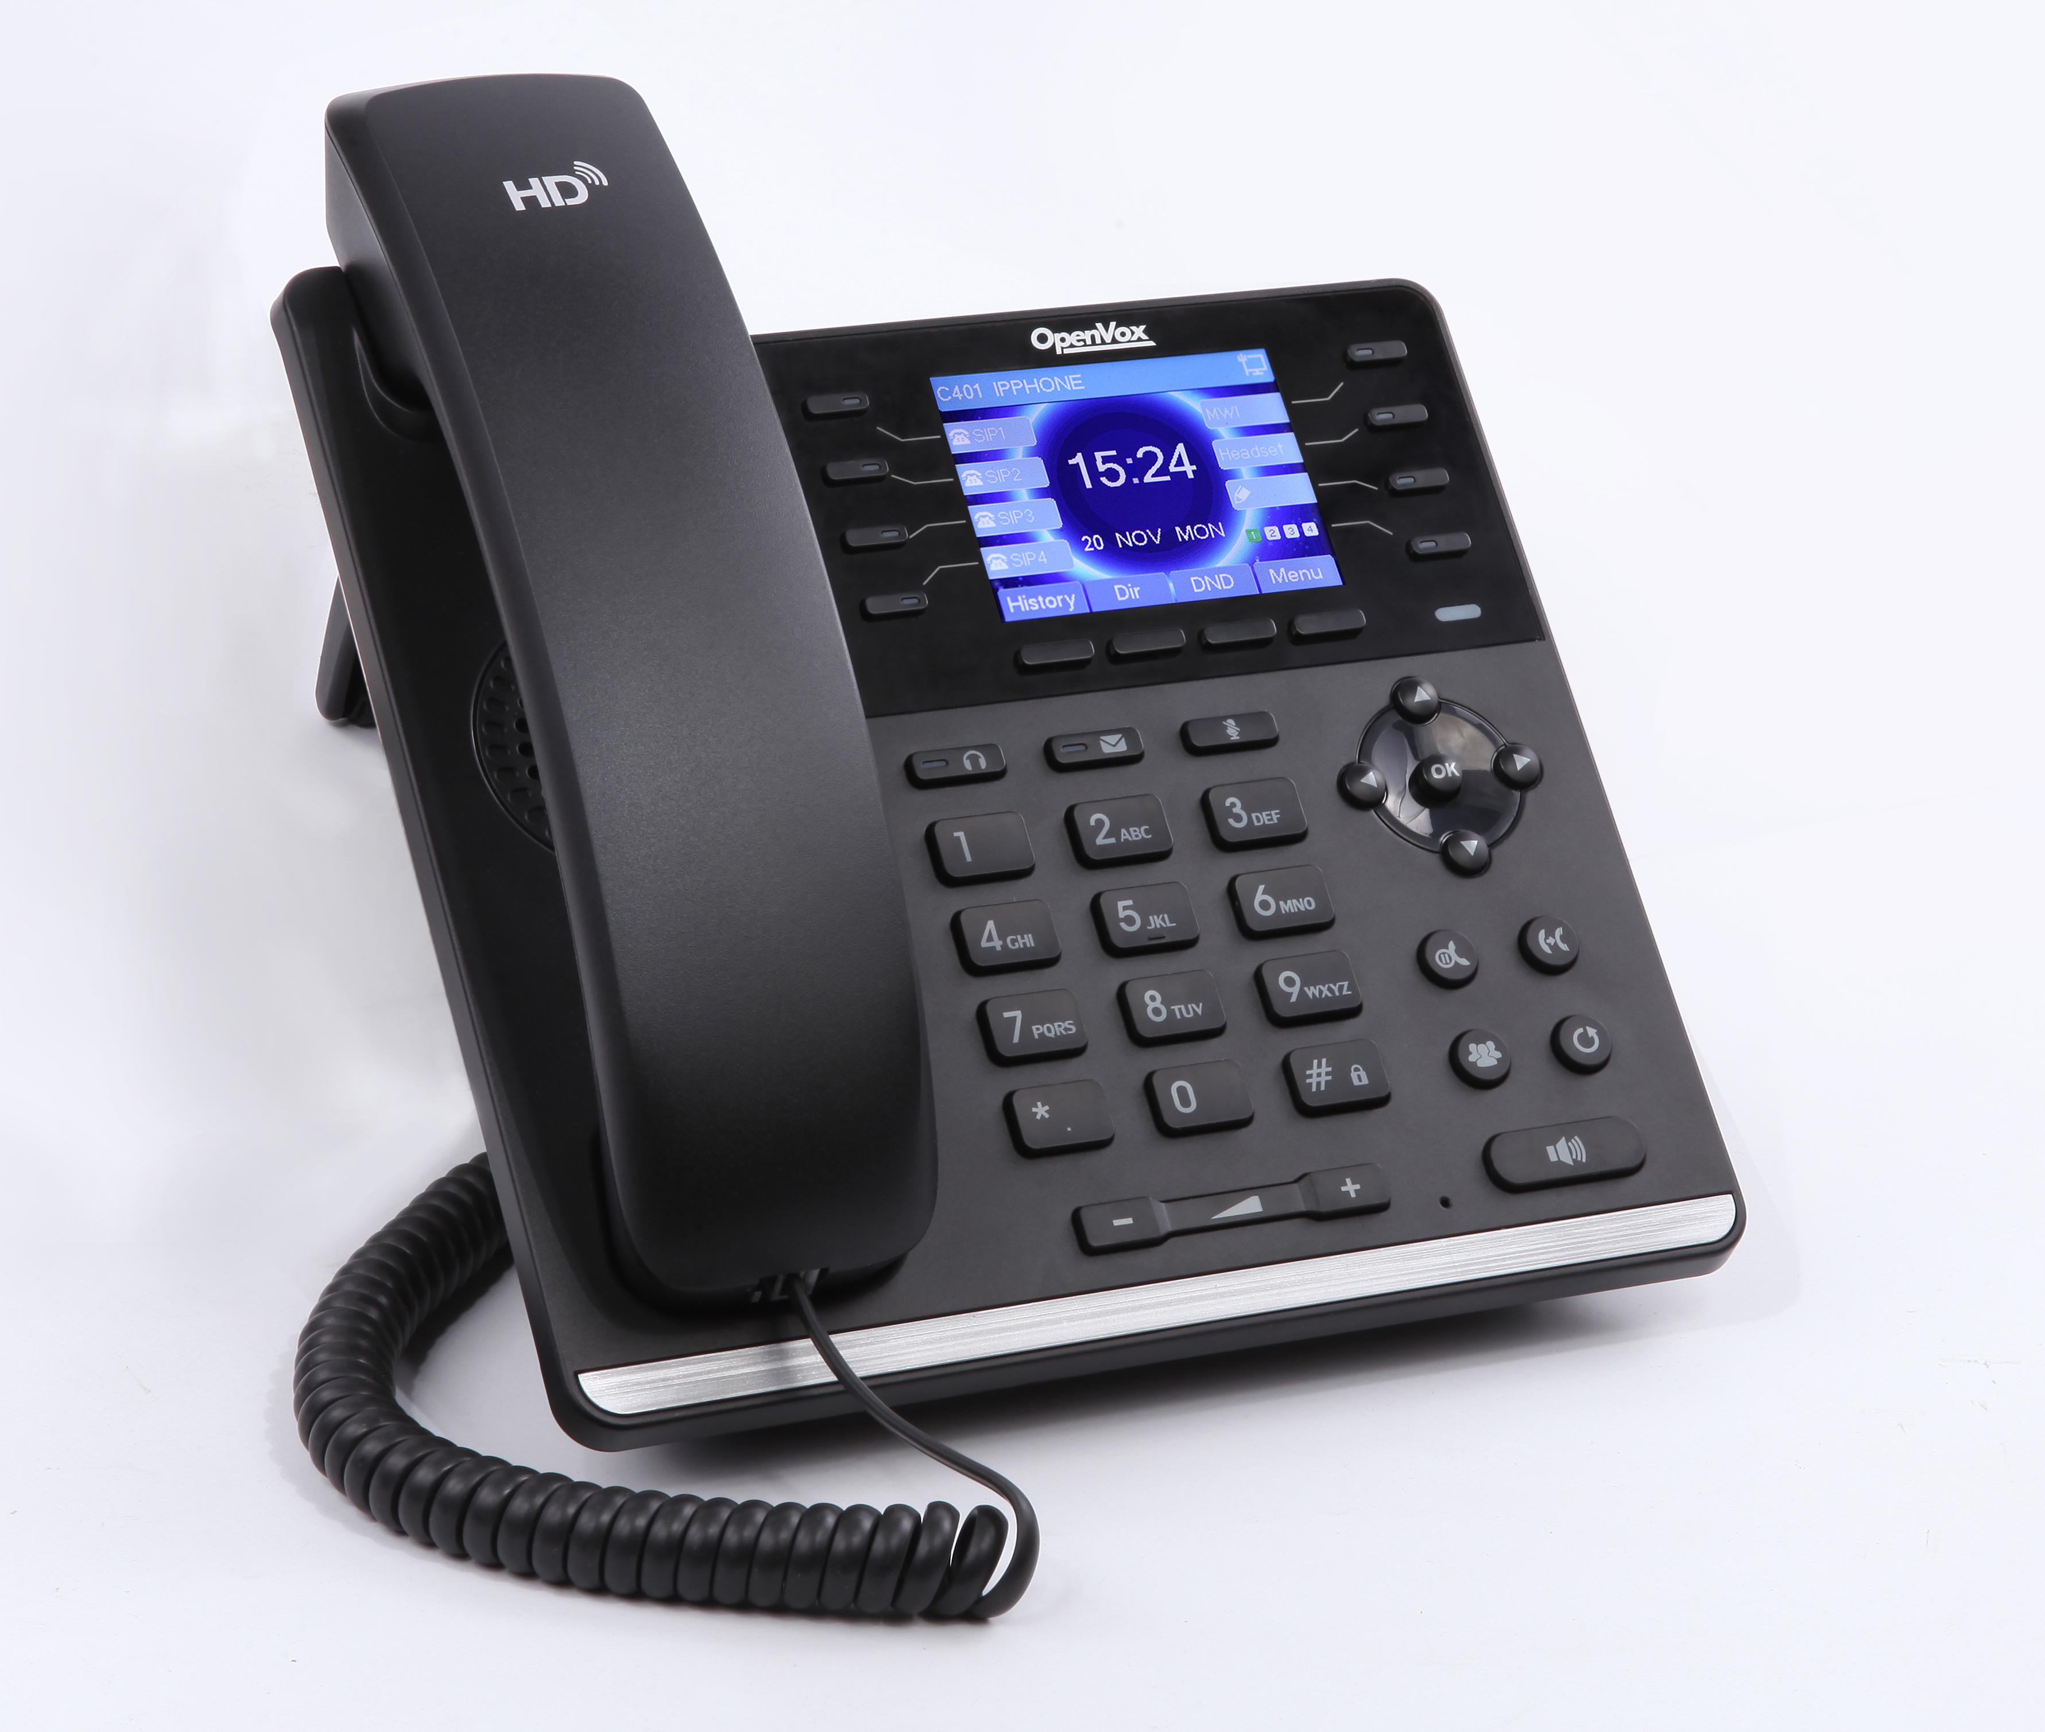
IP Phone —— C Series
VoxStack Series Wireless Gateway
01
02
C200
C401
Model | C200 | C401
SIP Line | 2 Lines | 4 Lines
Display | 128*48 dot-matrix with backlight screen | 2.8 inch LCD color-screen
Network | 1 * 10/100M | 1* 10/100/1000M
POE | 802.3af Class 1 POE | 802.3af Class 2 POE
Voice | HD Voice
VPN | OpenVPN

Slide 37
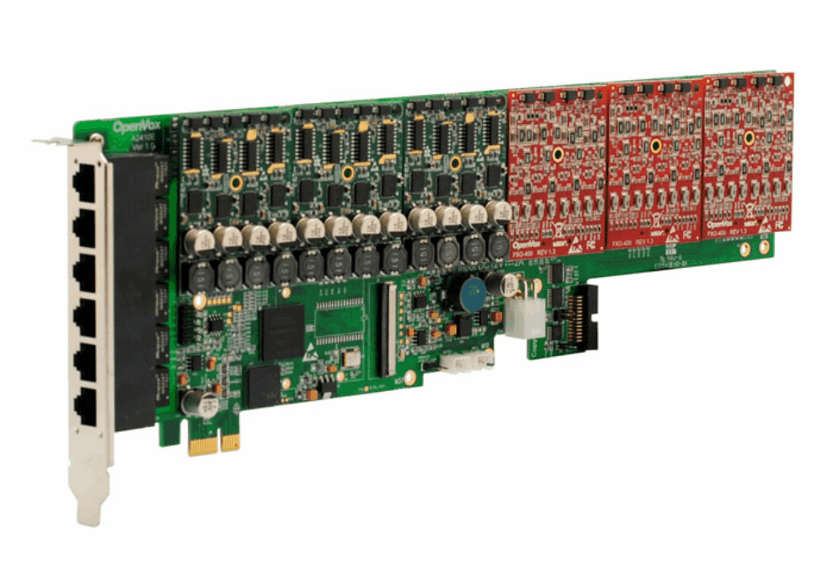
Products
④Telephony Cards
Analog Cards
A400、A810、A1610、A2410、FXS/O-100/400
ISDN BRI Cards
B100、B200、B400、B800
Digital Cards
D130、D230、D430、D830、D1630、D210、D410
Hybrid Cards
X204、B200M、D100M、FXO200M、FXS200M
Transcoding Cards
V100

Slide 38
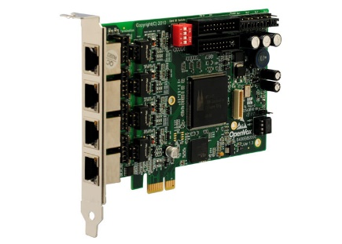
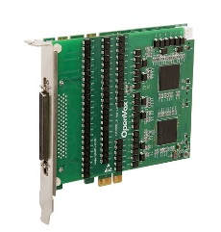
Telephone Cards
VoxStack Series Wireless Gateway
01
02
03
Analog Cards
ISDN BRI Cards
Digital Cards
Delivers the superior voice quality on both FXO and FXS interfaces in up to 24 ports
Contains 2 to 6 module banks
Each bank supports one analog interface
From 1 port to 8 ports of S/T BRI interface
Up to 16 Simultaneous Voice Calls over 8 ISDN BRI Lines
Optional hardware echo cancellers (DSP)
1 to 16 T1/E1/J1 ports
Up to 512 channels in E1 mode or 384 channels in T1/J1 modes
Supports up to 480 concurrent calls

Slide 39
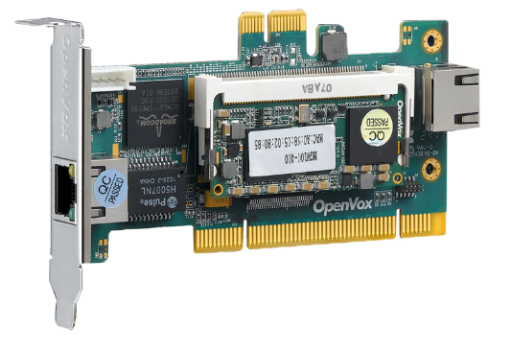
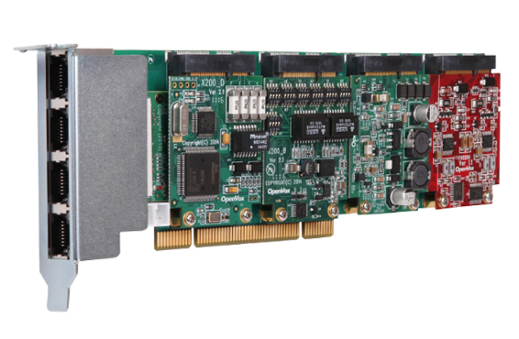
Telephone Cards
04
05
Transcoding Cards
Hybrid Cards
Comes with the industry’s first PCI & PCI-E form factors design in one Single board
Can handle up to 32/64/128/256/400 Codec transformations without additional licensing fees for transcoding
Provide PCI/PCI-E/RJ45/media/control flow paths
Supports 3 types interface: FXO/FXS, BRI and T1/E1/ J1
Each interface access 2 analog line
Provide 4 simultaneous voice calls over 2 ISDN BRI lines

Slide 40
“
04
Customers
COMPANY

Slide 41
Company Customers
With excellent product quality and efficient technical and logistic service support, OpenVox have won good reputation over 100 countries worldwide and have established a large and strong partner network with reliable distributors、resellers、system builders、various software and hardware strategic partners.
All our hardware products are ready to be used with leading open source telephony projects including Asterisk. And users can build advanced but affordable telephony systems themselves.

Slide 42
Company information
Add: Room 624, 6/F, Tsinghua Information Port, Book Building, Qingxiang Road, Longhua Street, Longhua District, Shenzhen, Guangdong, China 518109
PHONE: +0755－66630978
EMAIL: sales@openvox.cn
www.openvox.cn

Slide 43
THANKS
OpenVox
2022
OpenVox Communication Co., Ltd
VoIP Gateway
IP Communication System

